Slide 1
Cognitive Approach for Heart Disease Prediction using Machine Learning
Artificial Intelligence Project
Nazmus Sadat
Aisha Hayder Chowdhury
Student
Shahjalal University of Science and Technology, Sylhet

Slide 2

Introduction
A context-aware heart disease prediction system which guides you to live a better life.

Slide 3
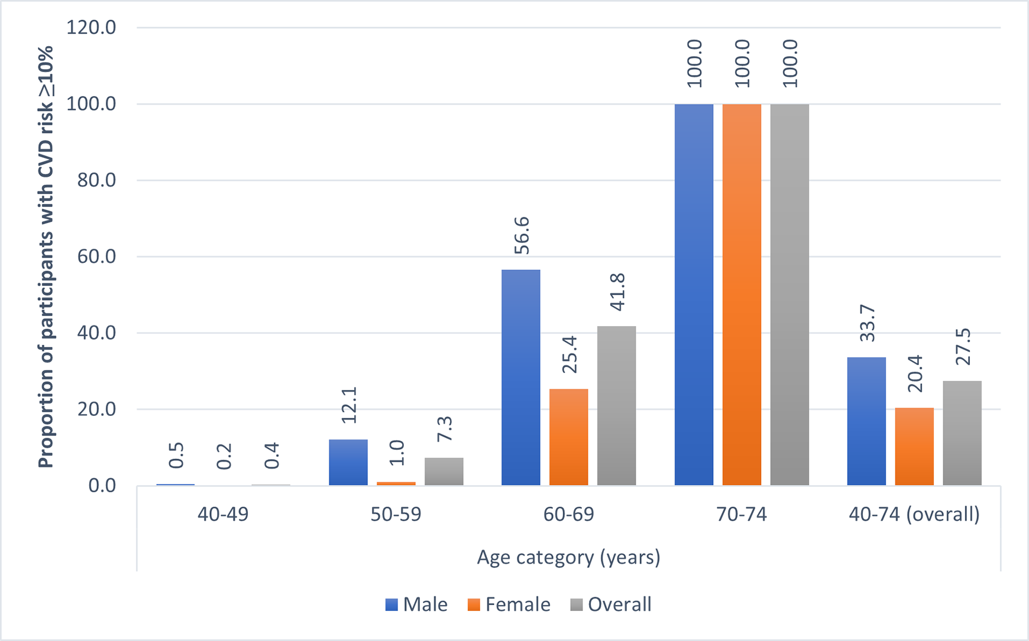
Introduction
Motivation
An estimate by WHO, over 17.9 deaths occur worldwide every year because of cardiovascular disease
Various risk factors like smoking, overuse of alcohol, hypertension, high blood cholesterol, high blood glucose, obesity, inactivity affect heart harshly
Hospitals’ huge amounts of data which have hidden relationships are untapped
Source : National Institute of Cardiovascular Disease

Slide 4
Our Approach to Prediction System
Collect and store patient’s data about medical conditions
Analyze the dataset and discover hidden patterns and relationships among attributes
A prediction system where whether a person has cardiovascular disease or not will be predicted.

Slide 5
Our Approach to Prediction System
By this prediction system to reduce medical errors, decrease unnecessary tests and reduce patient’s cost
Assist healthcare practitioners to make intelligent decisions

Slide 6
Dataset Preparation
Dataset Source:
The data has been extracted from kaggle.
Dataset Attributes:
Age
Height
Weight
Gender
Blood pressure
Glucose
Smoking
Alcohol
Physical activity
Presence of cardiovascular disease

Slide 7
Dataset Preparation
Dataset cleaning:
The dataset was clean
Missing values and outliers were handled
Dataset Normalization:
Age attribute was normalized
Height attribute was normalized

Slide 8
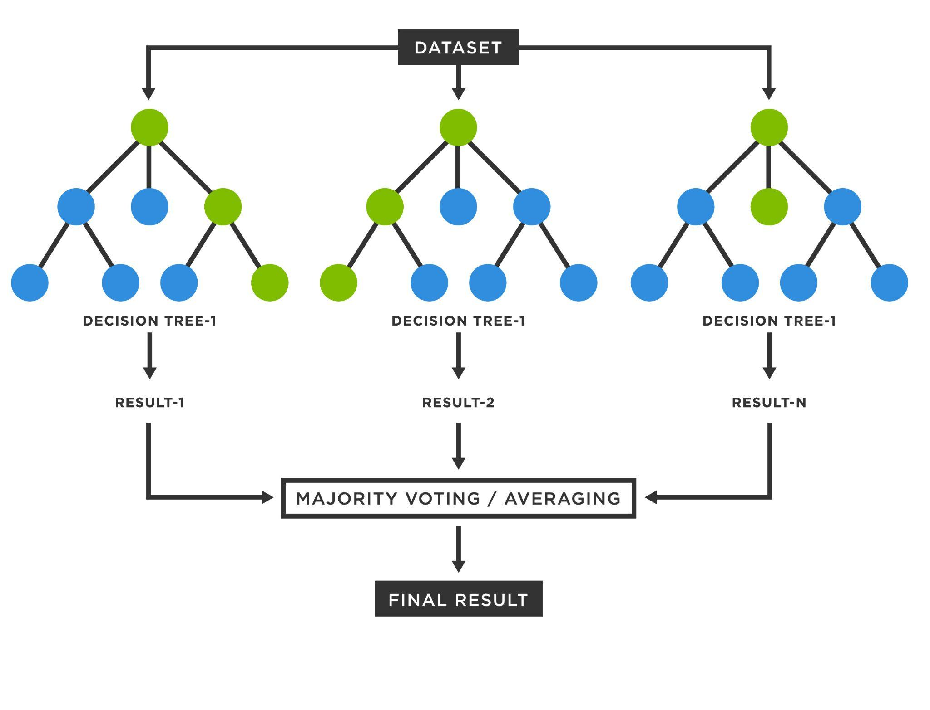
Methodology
Create bootstrap dataset
Generate multiple decision trees picking a random subset of attributes
Predict the target variable from all trees and pick the result based on majority votes.

Slide 9
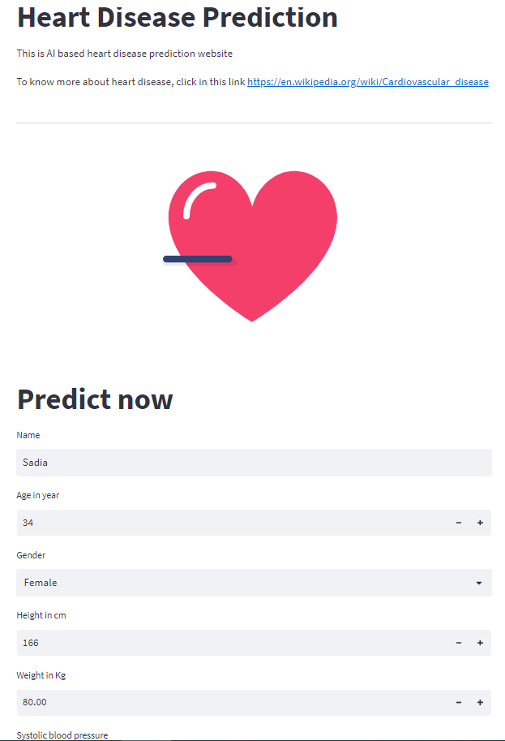
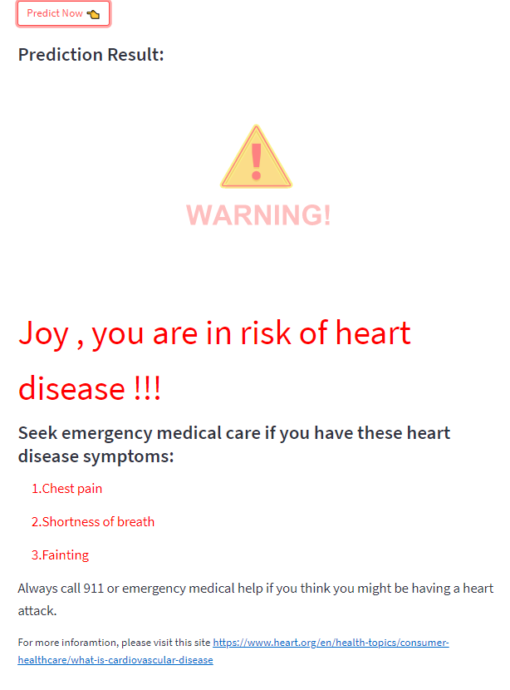
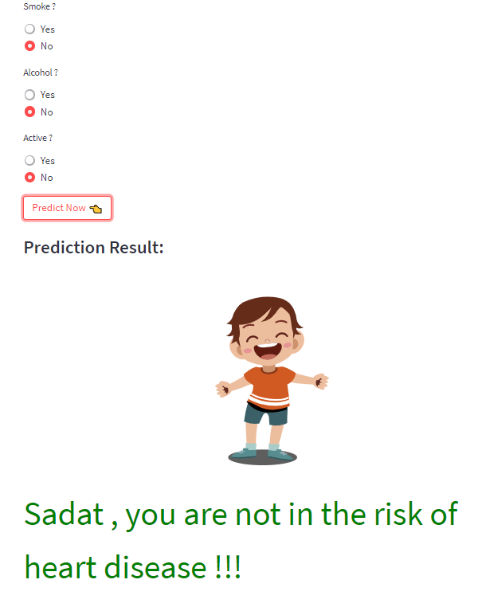
Web application using Streamlit

Slide 10
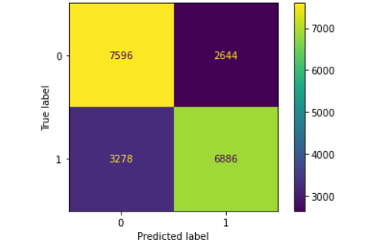
Performance evaluation
Figure: Confusion matrix

Slide 11
Conclusion
Our model predicts with an accuracy 72.10%
We plan on making our system more efficient
Make accurate prediction with lesser number of attributes or variables

Slide 12
Thank You

